Slide 1
Introduction to Statistical Investigations
Second Edition
Tintle, Chance, Cobb, Rossman, Roy, Swanson, VanderStoep
Chapter 11
Modeling Randomness
This slide deck contains animations. Please disable animations if they cause issues with your device.
Copyright ©2021 John Wiley & Sons, Inc.

Slide 2
Warmup
Cars vs. Goats: the "Switch" strategy
https://www.rossmanchance.com/applets/2021/montyhall/Monty.html

Slide 3
Probability
Last time, we used simulation to approximate the probabilities of two Cars or Goats strategies (stay/switch).
The probability of an event is the long-run proportion of times the event would occur if the random process were repeated indefinitely (under identical conditions).

Slide 4
Meaning of Probability
Math statement: “The probability of winning with the switch strategy is about 2/3.”
Meaning: If we play the cars/goats game a very large number of times using the switch strategy each time, then, in the long run, the overall proportion of games in which we win the car will approach 2/3.

Slide 5
Keys to interpreting probability
Random process: Play the cars/goats game using the switch strategy
Repetition: repeat a very large number of times (under identical conditions)
Event of interest: winning the game
Estimation: long-run proportion of times event occurs ”approaches” the true probability
Only the random process and event of interest depend on context.

Slide 6
Another Example
It has been reported that the probability of a new business closing or changing owners within its first three years is about 0.60.
Random process:
Event of interest:

Slide 7
Another Example
It has been reported that the probability of a new business closing or changing owners within its first three years is about 0.60.
Random process: randomly pick a business to examine
Event of interest: the business closing or changing owners within the first three years
Interpretation of probability:

Slide 8
Another Example
It has been reported that the probability of a new business closing or changing owners within its first three years is about 0.60.
Random process: randomly pick a business to examine
Event of interest: the business closing or changing owners within the first three years
Interpretation of probability: If we select businesses at random a very large number of times, then, in the long run, the proportion of businesses we select that close or change owners within the first three years will approach 60%.

Slide 9
Example 11.1: Ice Cream Prices (1 of 4)
Suppose that an ice cream shop offers a special promotion:
The price of a small ice cream cone will be determined randomly by rolling a pair of fair, six-sided dice.
The price, in cents, will be the larger number followed by the smaller number. (For example, if you roll a 2 and a 4, the price will be 42 cents.)
You enter the shop with two quarters (50 cents).
How likely is it that you’ll be able to afford to buy the ice cream cone?

Slide 10
Example 11.1: Ice Cream Prices (2 of 4)
Cold call: What is the smallest possible price of a cone?
Cold call: What is the largest possible price of a cone?
Do you think the probability you could afford the ice cream is more or less than 0.50?
You could simulate this probability by rolling a pair of dice 1,000 times and determine what proportion of times the result is 50 cents or less.

Slide 11
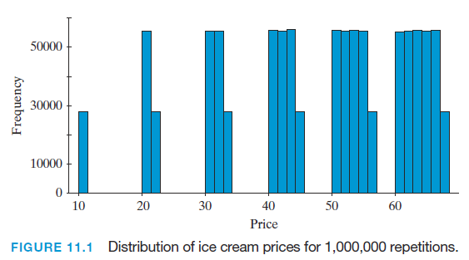
Example 11.1: Ice Cream Prices (3 of 4)
A computer simulated the results of 1,000,000 rolls of a pair of dice with the following results to simulate a distribution of ice cream prices for 1,000,000 repetitions

Slide 12
Example 11.1: Ice Cream Prices
Turn and Talk: How many different prices are possible?
Are they all about equally likely?
The proportion of simulated prices that are 50 cents or less is 444,991/1,000,000 or about 0.445

Slide 13
Example 11.1: Sample Space
The sample space of a random process lists all possible outcomes.
I will fill in the first row.
With your neighbors: Spend <3 minutes to write down as much as you can of the rest of the the sample space.
( 1 , 1 ) | ( 1 , 2 ) | ( 1 , 3 ) | ( 1 , 4 ) | ( 1 , 5 ) | ( 1 ,6 )
( 2 , ) | ( 2 , 2 ) | ( , ) | ( , ) | ( , ) | ( , )
( , ) | ( , ) | ( , ) | ( , ) | ( , ) | ( , )
( , ) | ( , ) | ( , ) | ( , ) | ( , ) | ( , )
( , ) | ( , ) | ( , ) | ( , ) | ( , ) | ( , )
( , ) | ( , ) | ( , ) | ( , ) | ( , ) | ( , )

Slide 14
Sample Space
The sample space of a random process lists all possible outcomes of the process.
Here’s the sample space for rolling two six-sided dice.
Is each outcome equally likely?
(1,1) | (1,2) | (1,3) | (1,4) | (1,5) | (1,6)
(2,1) | (2,2) | (2,3) | (2,4) | (2,5) | (2,6)
(3,1) | (3,2) | (3,3) | (3,4) | (3,5) | (3,6)
(4,1) | (4,2) | (4,3) | (4,4) | (4,5) | (4,6)
(5,1) | (5,2) | (5,3) | (5,4) | (5,5) | (5,6)
(6,1) | (6,2) | (6,3) | (6,4) | (6,5) | (6,6)

Slide 15
Example 11.1: Event (1 of 2)
An event is a collection of outcomes from the sample space.
The event we’re interested in is having the ice cream cost 50 cents or less.
Which outcomes in the sample space belong to the event “costs 50 cents or less”?
(1, 1) 11¢ | (1, 2) 21¢ | (1, 3) 31¢ | (1, 4) 41¢ | (1, 5) 51¢ | (1, 6) 61¢
(2, 1) 21¢ | (2, 2) 22¢ | (2, 3) 32¢ | (2, 4) 42¢ | (2, 5) 52¢ | (2, 6) 62¢
(3, 1) 31¢ | (3, 2) 32¢ | (3, 3) 33¢ | (3, 4) 43¢ | (3, 5) 53¢ | (3, 6) 63¢
(4, 1) 41¢ | (4, 2) 42¢ | (4, 3) 43¢ | (4, 4) 44¢ | (4, 5) 54¢ | (4, 6) 64¢
(5, 1) 51¢ | (5, 2) 52¢ | (5, 3) 53¢ | (5, 4) 54¢ | (5, 5) 55¢ | (5, 6) 65¢
(6, 1) 61¢ | (6, 2) 62¢ | (6, 3) 63¢ | (6, 4) 64¢ | (6, 5) 65¢ | (6, 6) 66¢

Slide 16
Example 11.1: Event (2 of 2)
The outcomes in the event that an ice cream costs 50 cents or less are highlighted below.
What is the probability you could afford the ice cream?
(1, 1) 11¢ | (1, 2) 21¢ | (1, 3) 31¢ | (1, 4) 41¢ | (1, 5) 51¢ | (1, 6) 61¢
(2, 1) 21¢ | (2, 2) 22¢ | (2, 3) 32¢ | (2, 4) 42¢ | (2, 5) 52¢ | (2, 6) 62¢
(3, 1) 31¢ | (3, 2) 32¢ | (3, 3) 33¢ | (3, 4) 43¢ | (3, 5) 53¢ | (3, 6) 63¢
(4, 1) 41¢ | (4, 2) 42¢ | (4, 3) 43¢ | (4, 4) 44¢ | (4, 5) 54¢ | (4, 6) 64¢
(5, 1) 51¢ | (5, 2) 52¢ | (5, 3) 53¢ | (5, 4) 54¢ | (5, 5) 55¢ | (5, 6) 65¢
(6, 1) 61¢ | (6, 2) 62¢ | (6, 3) 63¢ | (6, 4) 64¢ | (6, 5) 65¢ | (6, 6) 66¢

Slide 17
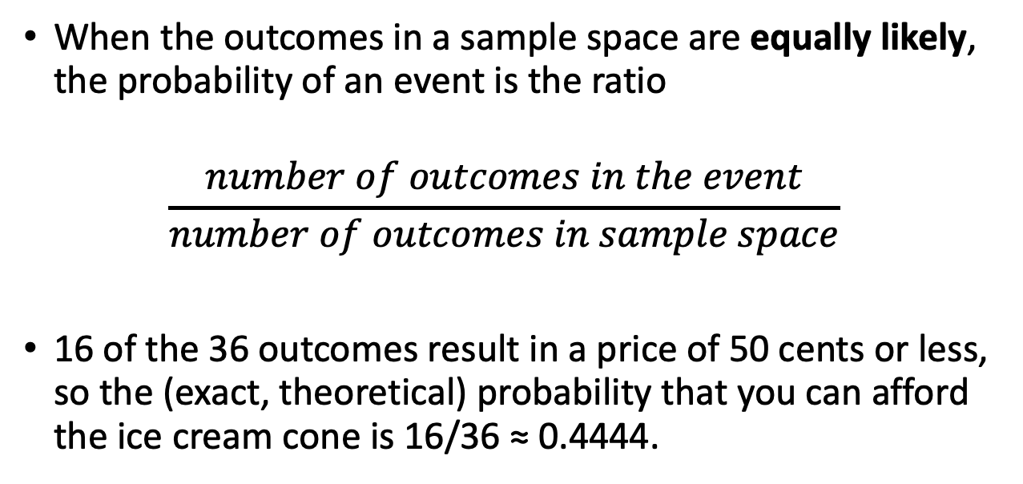
Example 11.1: Ice Cream Prices
When the outcomes in a sample space are equally likely, the probability of an event is the ratio
$$\frac{number of outcomes in the event}{number of outcomes in sample space}$$
16 of the 36 outcomes result in a price of 50 cents or less, so the (exact, theoretical) probability that you can afford the ice cream cone is 16/36 ≈ 0.4444.

Slide 18
Example 11.1: Ice Cream Prices
16 of the 36 outcomes result in a price of 50 cents or less, so the (exact, theoretical) probability that you can afford the ice cream cone is 16/36 ≈ 0.4444.
This means that if we were to repeat the die-rolling process for a very large number of rolls, the proportion of rolls for which the price would be 50 cents or less would be very close to 0.4444. So you would be able to afford the cone a little less than half the time in the long run.

Slide 19
Example 11.1: New Question
Now suppose that a friend offers to pay for your ice cream cone if the price (in cents) turns out to be an odd number.
Which prices in the sample space would your friend pay?
(1, 1) 11¢ | (1, 2) 21¢ | (1, 3) 31¢ | (1, 4) 41¢ | (1, 5) 51¢ | (1, 6) 61¢
(2, 1) 21¢ | (2, 2) 22¢ | (2, 3) 32¢ | (2, 4) 42¢ | (2, 5) 52¢ | (2, 6) 62¢
(3, 1) 31¢ | (3, 2) 32¢ | (3, 3) 33¢ | (3, 4) 43¢ | (3, 5) 53¢ | (3, 6) 63¢
(4, 1) 41¢ | (4, 2) 42¢ | (4, 3) 43¢ | (4, 4) 44¢ | (4, 5) 54¢ | (4, 6) 64¢
(5, 1) 51¢ | (5, 2) 52¢ | (5, 3) 53¢ | (5, 4) 54¢ | (5, 5) 55¢ | (5, 6) 65¢
(6, 1) 61¢ | (6, 2) 62¢ | (6, 3) 63¢ | (6, 4) 64¢ | (6, 5) 65¢ | (6, 6) 66¢

Slide 20
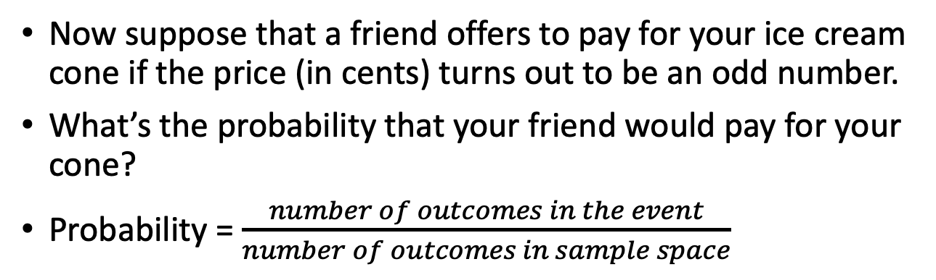
Example 11.1: New Question
Now suppose that a friend offers to pay for your ice cream cone if the price (in cents) turns out to be an odd number.
What’s the probability that your friend would pay for your cone?
Probability = $\frac{number of outcomes in the event}{number of outcomes in sample space}$
(1, 1) 11¢ | (1, 2) 21¢ | (1, 3) 31¢ | (1, 4) 41¢ | (1, 5) 51¢ | (1, 6) 61¢
(2, 1) 21¢ | (2, 2) 22¢ | (2, 3) 32¢ | (2, 4) 42¢ | (2, 5) 52¢ | (2, 6) 62¢
(3, 1) 31¢ | (3, 2) 32¢ | (3, 3) 33¢ | (3, 4) 43¢ | (3, 5) 53¢ | (3, 6) 63¢
(4, 1) 41¢ | (4, 2) 42¢ | (4, 3) 43¢ | (4, 4) 44¢ | (4, 5) 54¢ | (4, 6) 64¢
(5, 1) 51¢ | (5, 2) 52¢ | (5, 3) 53¢ | (5, 4) 54¢ | (5, 5) 55¢ | (5, 6) 65¢
(6, 1) 61¢ | (6, 2) 62¢ | (6, 3) 63¢ | (6, 4) 64¢ | (6, 5) 65¢ | (6, 6) 66¢

Slide 21
Example 11.1: Newer Question
What’s the probability that your friend would pay for your ice cream cone or you have enough money to pay for it?
(1, 1) 11¢ | (1, 2) 21¢ | (1, 3) 31¢ | (1, 4) 41¢ | (1, 5) 51¢ | (1, 6) 61¢
(2, 1) 21¢ | (2, 2) 22¢ | (2, 3) 32¢ | (2, 4) 42¢ | (2, 5) 52¢ | (2, 6) 62¢
(3, 1) 31¢ | (3, 2) 32¢ | (3, 3) 33¢ | (3, 4) 43¢ | (3, 5) 53¢ | (3, 6) 63¢
(4, 1) 41¢ | (4, 2) 42¢ | (4, 3) 43¢ | (4, 4) 44¢ | (4, 5) 54¢ | (4, 6) 64¢
(5, 1) 51¢ | (5, 2) 52¢ | (5, 3) 53¢ | (5, 4) 54¢ | (5, 5) 55¢ | (5, 6) 65¢
(6, 1) 61¢ | (6, 2) 62¢ | (6, 3) 63¢ | (6, 4) 64¢ | (6, 5) 65¢ | (6, 6) 66¢

Slide 22
Section 11.2
Probability Rules

Slide 23
Section 11.2: Introduction
In Sections P.3 and 11.1, you learned how to use simulation to approximate probabilities, and you saw how to calculate exact probabilities in situations where outcomes are equally likely.
Today you'll learn mathematical rules that enable you to determine exact probabilities of some complicated situations.

Slide 24
Example 11.2: Watching Films (1 of 2)
In 2007, the American Film Institute created a list of the top 100 American films ever made.
Two people, Allan and Beth, classified each film according to whether or not they had seen it at the time.
Number of films that Beth and Allan have seen (and not seen) from the list of the top 100 films
 | Beth Yes | Beth No | Total
Allan Yes | 42 | 6 | 48
Allan No | 17 | 35 | 52
Total | 59 | 41 | 100

Slide 25
Example 11.2: Watching Films (2 of 2)
If a film from the list is chosen at random:
The probability Allan had seen it is 48/100 or P(A) = 0.48 where A is the event Allan has seen the film.
The probability Beth had seen it is 59/100 or P(B) = 0.59 where B is the event Beth has seen the film.
Key Idea: All probabilities are between 0 and 1, inclusive, so the probability of an event A is 0 ≤ P(A) ≤ 1
 | Beth Yes | Beth No | Total
Allan Yes | 42 | 6 | 48
Allan No | 17 | 35 | 52
Total | 59 | 41 | 100

Slide 26
Example 11.2: Complement
The complement of an event A, denoted by A^{C}, is the event that A does not occur.
The probability of a complement can be calculated as: P(A^{C}) = 1 − P(A). This is called the complement rule.
What is the probability Allan has not seen a film on the list?
 | Beth Yes | Beth No | Total
Allan Yes | 42 | 6 | 48
Allan No | 17 | 35 | 52
Total | 59 | 41 | 100

Slide 27
Example 11.2: Intersection
When two events A and B both occur at the same time, we call this the intersection of the two events.
It is common to use the symbol ∩ to denote the intersection of A and B
A ∩ B is read as “A intersect B” or more commonly, “A and B”
For a randomly selected film, what’s the probability that both Allan and Beth have seen the film?
 | Beth Yes | Beth No | Total
Allan Yes | 42 | 6 | 48
Allan No | 17 | 35 | 52
Total | 59 | 41 | 100

Slide 28
Example 11.2: Union (1 of 2)
When either event A and/or event B occurs, we call this the union of the two events
It is common to use the symbol ∪ to denote the union of A and B
A ∪ B is read as “A union B” or more commonly, “A or B”
For a randomly selected film, what’s the probability that either Allan or Beth has seen the film?
 | Beth Yes | Beth No | Total
Allan Yes | 42 | 6 | 48
Allan No | 17 | 35 | 52
Total | 59 | 41 | 100

Slide 29
Example 11.2: Union (2 of 2)
Why can’t we just add the probability Allen has seen a film, P(A), to the probability that Beth has seen the film, P(B), to find the probability that either Allan or Beth has seen the film, P(A or B)?
What would we double count if we just added?
 | Beth Yes | Beth No | Total
Allan Yes | 42 | 6 | 48
Allan No | 17 | 35 | 52
Total | 59 | 41 | 100
Notes:
Easier to see with a venn diagram

Slide 30
Example 11.2: Addition Rule
For two events A and B, the probability that either A or B (or both) occurs is given by
P(A ∪ B) = P(A) + P(B) − P(A ∩ B).
This addition rule says that to determine the probability of one event or another (or both) occurring, add the probabilities of the individual events and then subtract the probability of the intersection of the two events—those outcomes that are part of both events.
 | Beth Yes | Beth No | Total
Allan Yes | 42 | 6 | 48
Allan No | 17 | 35 | 52
Total | 59 | 41 | 100

Slide 31
Example 11.2: Addition Rule
For two events A and B, the probability that either A or B (or both) occurs is given by
P(A ∪ B) = P(A) + P(B) − P(A ∩ B).
P(A ∪ B) = 48/100 + 59/100 − 42/100 = 65/100 =0.65.
How else could we calculate P(A ∪ B)?
 | Beth Yes | Beth No | Total
Allan Yes | 42 | 6 | 48
Allan No | 17 | 35 | 52
Total | 59 | 41 | 100

Slide 32
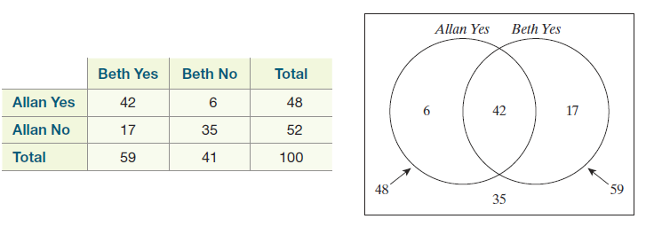
Example 11.2: Venn Diagram
A Venn diagram uses partially overlapping circles, one circle for each event, to indicate the counts or probabilities of different combinations of events or their complements.

Slide 33
Example 11.2: Probability Table
A probability table contains probabilities, rather than counts, for all outcomes in the sample space.
 | Beth Yes | Beth No | Total
Allan Yes | 42 | 6 | 48
Allan No | 17 | 35 | 52
Total | 59 | 41 | 100
 | Beth Yes | Beth No | Total
Allan Yes | 0.42 | 0.06 | 0.48
Allan No | 0.17 | 0.35 | 0.52
Total | 0.59 | 0.41 | 1.00

Slide 34
Example 11.2: Mutually Exclusive
Two events A and B are mutually exclusive (disjoint) when it is impossible for both of them to occur simultaneously. In other words, P(A and B) = 0.
In this special case, P(A ∪ B) = P(A) + P(B).

Slide 35
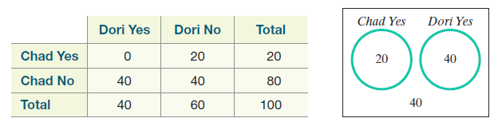
Example 11.2: Mutually Exclusive
Consider two other people, Chad and Dori and if they have seen a film on the top 100 list.
In this case, events C (Chad has seen the movie) and D (Dori has seen the movie) are mutually exclusive, because they have not seen any of the same movies!
What is P(C ∪ D)?

Slide 36
Exploration: Ice Cream Prices

Slide 37
(1, 1) 11¢ | (1, 2) 21¢ | (1, 3) 31¢ | (1, 4) 41¢ | (1, 5) 51¢ | (1, 6) 61¢
(2, 1) 21¢ | (2, 2) 22¢ | (2, 3) 32¢ | (2, 4) 42¢ | (2, 5) 52¢ | (2, 6) 62¢
(3, 1) 31¢ | (3, 2) 32¢ | (3, 3) 33¢ | (3, 4) 43¢ | (3, 5) 53¢ | (3, 6) 63¢
(4, 1) 41¢ | (4, 2) 42¢ | (4, 3) 43¢ | (4, 4) 44¢ | (4, 5) 54¢ | (4, 6) 64¢
(5, 1) 51¢ | (5, 2) 52¢ | (5, 3) 53¢ | (5, 4) 54¢ | (5, 5) 55¢ | (5, 6) 65¢
(6, 1) 61¢ | (6, 2) 62¢ | (6, 3) 63¢ | (6, 4) 64¢ | (6, 5) 65¢ | (6, 6) 66¢

Slide 38
Section 11.3
Conditional Probability and Independence

Slide 39
Example 11.3: Watching Films (1 of 2)
Remember our breakdown of how many films Beth and Allan have seen from a list of the top 100 films ever made.
Suppose again that one of these 100 films is chosen at random.
 | Beth Yes | Beth No | Total
Allan Yes | 42 | 6 | 48
Allan No | 17 | 35 | 52
Total | 59 | 41 | 100

Slide 40
Example 11.3: Watching Films (2 of 2)
If a film from the list is chosen at random, the probability Beth had seen it is 59/100 or P(B) = 0.59 where B is the event Beth has seen the film.
But now suppose you are told that the film that has been randomly chosen has been seen by Allan.
Does this change the probability that Beth has seen it? Is Beth more or less likely to have seen the film?
 | Beth Yes | Beth No | Total
Allan Yes | 42 | 6 | 48
Allan No | 17 | 35 | 52
Total | 59 | 41 | 100
Notes:
Notice that there are 48 movies that Allan has seen. Because we're told that Allan has seen
the movie, we now know that one of these 48 movies has been chosen. This means that the sample space has been reduced to those 48 movies. We also know that, of those 48 movies, Beth has seen 42 of them.

Slide 41
Example 11.3: Conditional Probability (1 of 2)
The conditional probability of B given A is represented P(B|A) and is the probability that B occurs if we know that A has occurred.
Of the 48 movies Allan has seen, Beth has seen 42 of them.
Thus, the conditional probability that Beth has seen the film given that Allan has seen it is P(B|A) = 42/48 = 0.875
Is this larger than the original probability that Beth has seen the film? Why?
 | Beth Yes | Beth No | Total
Allan Yes | 42 | 6 | 48
Allan No | 17 | 35 | 52
Total | 59 | 41 | 100
Notes:
0.59 vs 0.875, yep.

Slide 42
Example 11.3: Conditional Probability (2 of 2)
Notice that our equation for the probability that Beth has seen the film given that Allan has seen it suggests a formula for conditional probability
The conditional probability of event B, given that event A has occurred is:

Slide 43
Example 11.3: Independence (1 of 3)
Two events A and B are said to be independent if P(B|A) = P(B).
In other words, knowing that event A has occurred, does not change the probability that event B will occur.
If two events are not independent, they are said to be dependent.
In other words, knowing that event A has occurred does change the probability that event B will occur.
Are the events Allan has seen the film and Beth has seen the film independent?
Does P(B|A) = P(B)?

Slide 44
Example 11.3: Independence (2 of 3)
No, the event that Allan has seen the film is not independent of the event that Beth has seen the film.
Before we knew that Allan had the seen the film, there was a 59% chance Beth had seen it, but this probability increased to 87.5% if we knew that Allan had seen it.
Because P(B|A) ≠ P(B), the events that Allan has seen the film and Beth has seen the film are not independent.

Slide 45
Example 11.3: Independence (3 of 3)
Consider a randomly selected film for Chuck and Donna.
Does the knowledge that Chuck has seen the film change the probability that Donna has seen it?
In other words is the event that Chuck has seen the film and the event that Donna has seen the film independent?
 | Donna Yes | Donna No | Total
Chuck Yes | 15 | 10 | 25
Chuck No | 45 | 30 | 75
Total | 60 | 40 | 100

Slide 46
Example 11.3: Independence (3 of 3)
Knowing that Chuck has seen the film provides no additional information regarding the chances that Donna has seen the film.
Therefore, the events are independent.
 | Donna Yes | Donna No | Total
Chuck Yes | 15 | 10 | 25
Chuck No | 45 | 30 | 75
Total | 60 | 40 | 100

Slide 47
Example 11.3: Multiplication Rule
We can rearrange the conditional probability formula, P(B|A) = P(A ∩ B) / P(A) to get the general multiplication rule.
The general multiplication rule allows you to calculate the probability that two events both occur (intersection), based on one of their probabilities and the conditional probability of the other event given the first:
P(A ∩ B) = P(A) × P(B|A)
P(A ∩ B) = P(B) × P(A|B).

Slide 48
Example
Suppose that you have applied to colleges G and H.
You have a 0.70 probability of acceptance by G, and the conditional probability of acceptance by H given acceptance by G is 0.90.
What is the probability of being accepted by both G and H?

Slide 49
Example 11.3: Multiplication Rule
If A and B are independent events, then this rule simplifies to the multiplication rule for independent events
P(A ∩ B) = P(A) × P(B)
Why does the multiplication rule simplify this way for independent events?
If two fair coins are tossed, what is the probability of both landing on heads?

Slide 50
Tree Diagrams
A tree diagram organizes conditional probabilities with a node representing an event and branches from the node representing the possible outcomes associated with the event.

Slide 51
Tree Diagrams
To construct a tree, start by creating a single node, and split it into different outcomes. Label each branch with an event and the event’s probability.
In this example, we chose
a movie at random and
indicate two complementary
events: ”Allan has seen it”
and ”Allan hasn’t seen it.”

Slide 52
Tree Diagrams
Next, split each branch into another set of outcomes. Record the conditional probability of each event on the branches.

Slide 53
Tree Diagrams
Next, split each branch into another set of outcomes. Record the conditional probability of each event on the branches.

Slide 54
Tree Diagrams
Finally, use the multiplication rule to compute the intersection probabilities along each path in the tree.

Slide 55
Tree Diagrams
Important: You can find the (unconditioned) probability of the second event by adding appropriate intersection probabilities.

Slide 56
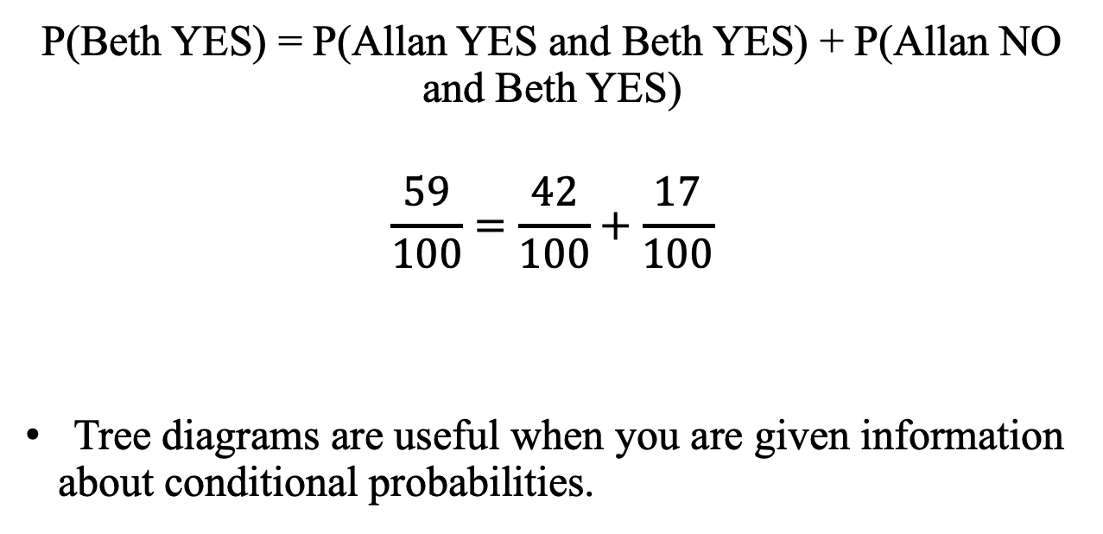
Tree Diagrams
P(Beth YES) = P(Allan YES and Beth YES) + P(Allan NO and Beth YES)
$$\frac{59}{100}=\frac{42}{100}+\frac{17}{100}$$
Tree diagrams are useful when you are given information about conditional probabilities.

